Slide 1

US and Canada Investment Outlook
Eshan Mukherjee
Sept. 30, 2025

Slide 2
Market Mispricing Stagflation Risk
Consensus: Soft landing (slowing inflation + job creation)
Recommendation: We recommend initiating a long position in the Consumer Staples Select Sector SPDR Fund (XLP).
Data: Slowing GDP + slowing job growth + sticky inflation.
Federal Reserve: FED forced to lower rates to combat a weakening economy, while inflation remains above 2% target.

Slide 3


Economic Outlook
 | 2025F | 2026F | 2027F
Real GDP (YoY%) | 1.8 | 1.8 | 2.0
CPI (YoY%) | 2.8 | 2.9 | 2.5
Unemployment (%) | 4.3 | 4.4 | 4.3
Budget (% of GDP) | -6.2 | -6.5 | -6.4
Central Bank Rate (%) | 3.87 | 3.30 | 3.23
 | 2025F | 2026F | 2027F
Real GDP (YoY%) | 1.2 | 1.2 | 1.9
CPI (YoY%) | 2.0 | 2.0 | 2.0
Unemployment (%) | 7.0 | 6.9 | 6.5
Budget (% of GDP) | -1.5 | -2.0 | -2.1
Central Bank Rate (%) | 2.25 | 2.25

Slide 4
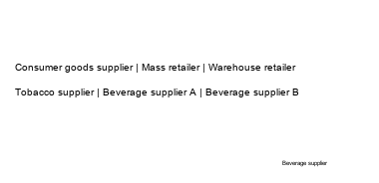
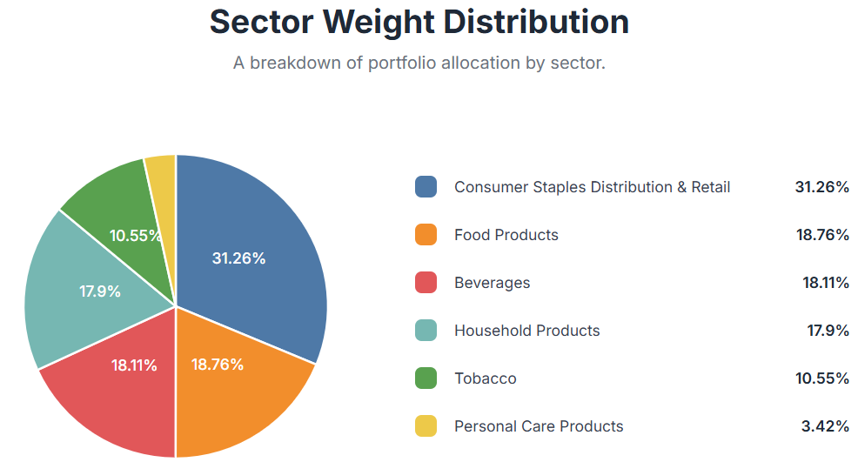
A Look Inside XLP
Metric | Value
Expense Ratio | 0.08%
AUM | $15.7B
Number of holdings | 37
Beta | 0.67
30-day median bid/ask spread | 0.01%
Average daily volume | $1.2B (15.5M shares x $78)

Slide 5
Why XLP is the optimal play?
Companies: Characterized by non-cyclical demand
History: Consumer staples has outperformed in both inflationary and slow-growth environments.
Exposure: Gain exposure to the US equity market with good quality companies while partially hedging against a downturn.
Time Period | S&P 500 (SPY) | Consumer Staples (XLP)
2000 Tech Bubble (3/24/00 - 10/9/02) | -47.50% | +1.17%
2008 Financial Crisis (10/9/07 - 3/9/09) | -55.20% | -28.51%
2020 COVID Crash (2/19/20 - 3/23/20) | -33.70% | -24.51%
2022 High Inflation (1/3/22 - 10/12/22) | -24.50% | -10.64%
Notes:
The key takeaway is clear: in the exact stagflationary conditions we forecast - slow growth and high inflation - history shows that XLP provides superior, defensive returns.

Slide 6
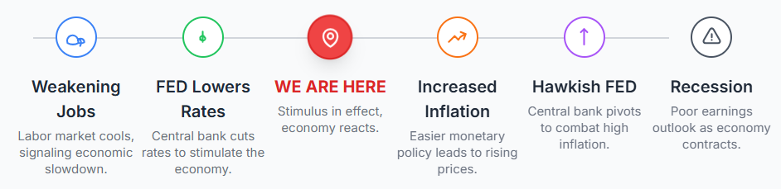
Catalysts & Timeline

