Slide 1
Restaurant Chain Acquires
Salad Restaurant Chain
A New Generation of Taste
April 23, 2024

Slide 2


Agenda
I. Transaction Highlights
II. Company Backgrounds
III. Strategic Rationale
IV. Value Creation
V. Financial Impact
VI. Risks
VII. Antitrust
VIII. Approach Strategy
2

Slide 3
I. Transaction Highlights
II. Company Backgrounds
III. Strategic Rationale
IV. Value Creation
V. Financial Impact
VI. Risks
VII. Antitrust
VIII. Approach Strategy
Agenda
3

Slide 4
Transaction Overview
Consideration
Opening offer of $24.00 per share, consideration up to $27.88
All cash offer reﬂecting a total equity value up to $3.15B
Funding
Will be fully debt ﬁnanced by a total of $2.9B
Debt will be amortized over 10 years
Timeline
We recommend execution to occur early to mid 2025
Current market conditions are not conducive to debt-heavy M&A
Beneﬁts to Restaurant Chain
Salad chain offers technological advancements and automation
The current deal structure is accretive by 10.28% after 3 years
Beneﬁts to Salad chain
Salad chain is offered up to a 37% premium on their current price
Supply chain and corporate integration with an established ﬁrm
4

Slide 5
I. Transaction Highlights
II. Company Backgrounds
III. Strategic Rationale
IV. Value Creation
V. Financial Impact
VI. Risks
VII. Antitrust
VIII. Approach Strategy
Agenda
5

Slide 6
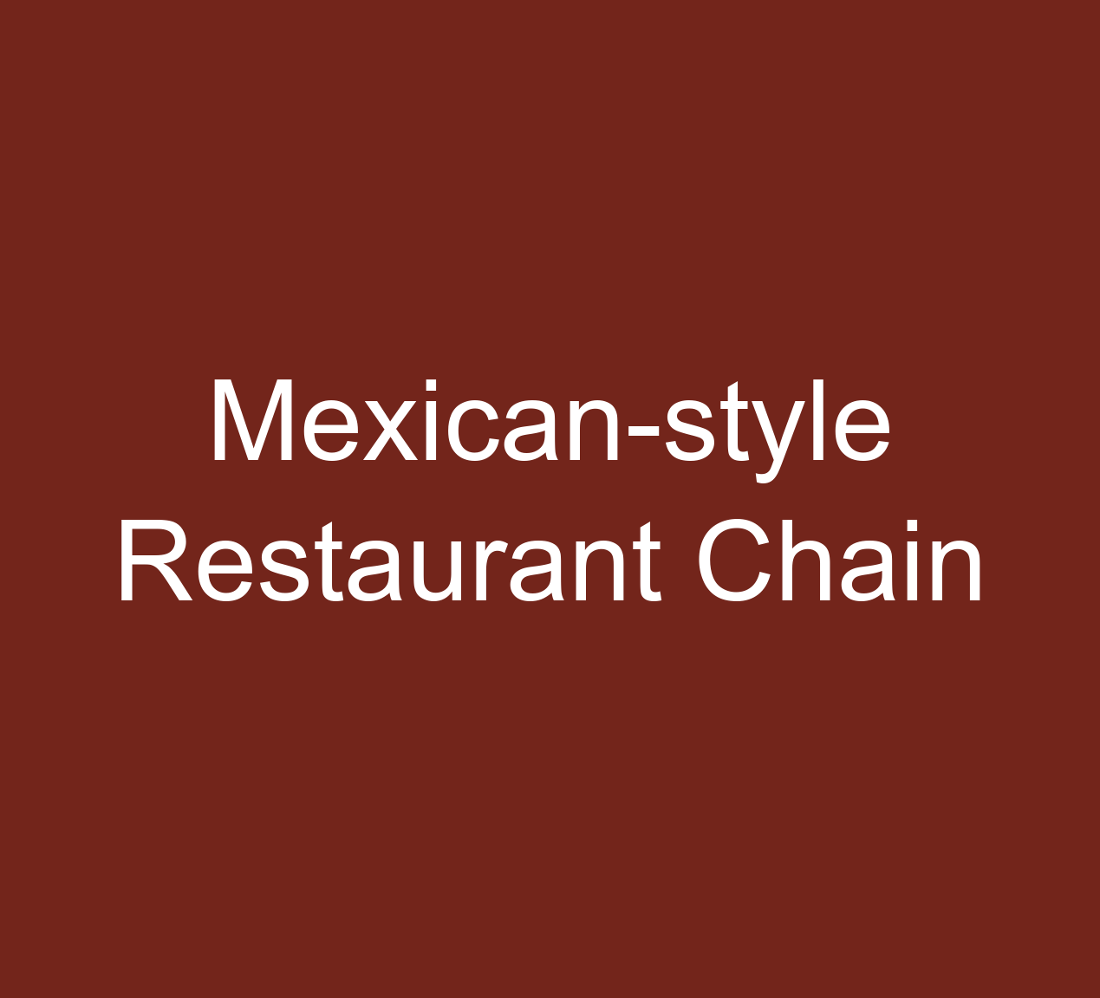
Restaurant Chain’s Company Overview
Business Description:
Restaurant Chain Mexican Grill is a mexican fast-casual food chain specializing in fresh high quality ingredients and customizable meals
At a glance:
Founded: 1993 in Denver, Colorado, by Steve Falls with a loan from his father of $85,000
Headquartered: Newport Beach, California
Restaurant Chain operates 3,398 location in 49 states
Business Model: Owns and operates all its locations and does not utilize a franchise model (focused on internal growth)
IPO: $22 per share, nearly 8 million shares issued
Investments:
  Venture fund: $100 million fund that invests in early-stage companies aligned with its mission for a better food system and accelerated growth
    Investments: agricultural software, robotics and kitchen automation.
Financial Summary
Share Price | $ 2,884.25
52 Week Range | $ 1,768.64 - 3,023.98
Total Debt | $ 4.05B
Cash | $ 1.3B
Market Cap | $ 78.67B
Revenue LTM | $ 9.87B
Shares Outstanding | 27.55mn
.
6

Slide 7
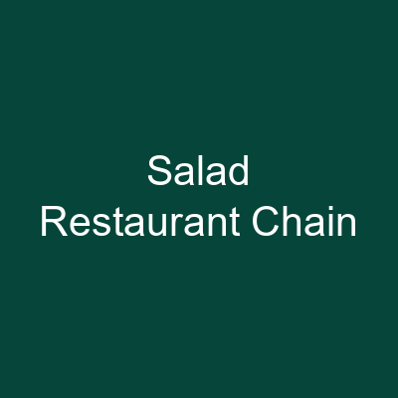
Salad Restaurant Chain’s Company Overview
Business Description:
Salad chain Inc. is a healthy alternative to fast food, offering customizable, fresh, high-quality salads made with locally sourced ingredients
At a glance:
Founded: 2011 by Georgetown students seeking a healthy
alternative to fast food
Headquartered: Los Angeles, CA
Salad chain currently has over 140 location across 13 states
IPO: $28 per share, 13 million shares issued
Acquisitions:
  Prepared-meal provider, a DC-based company which provided heat-and-serve meals in 2019 to expand its offering from just salads
  Robotic-kitchen startup, a Boston-based startup which operated robotic kitchens that prepared fresh, customizable warm bowls, in 2021 for $50 million with a goal of integrating the technology into their restaurant
Financial Summary
Share Price | $ 20.65
52 Week Range | $ 7.25 - 26.45
Total Debt | $ 302.86mn
Cash | $ 257.23mn
Market Cap | $ 2.33B
Revenue LTM | $ 584.04mn
Shares Outstanding | 100.05mn
7

Slide 8
I. Transaction Highlights
II. Company Backgrounds
III. Strategic Rationale
IV. Value Creation
V. Financial Impact
VI. Risks
VII. Antitrust
VIII. Approach Strategy
Agenda
8

Slide 9
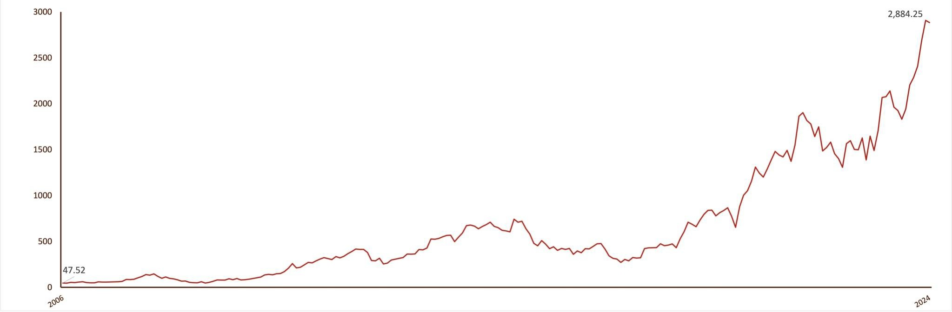
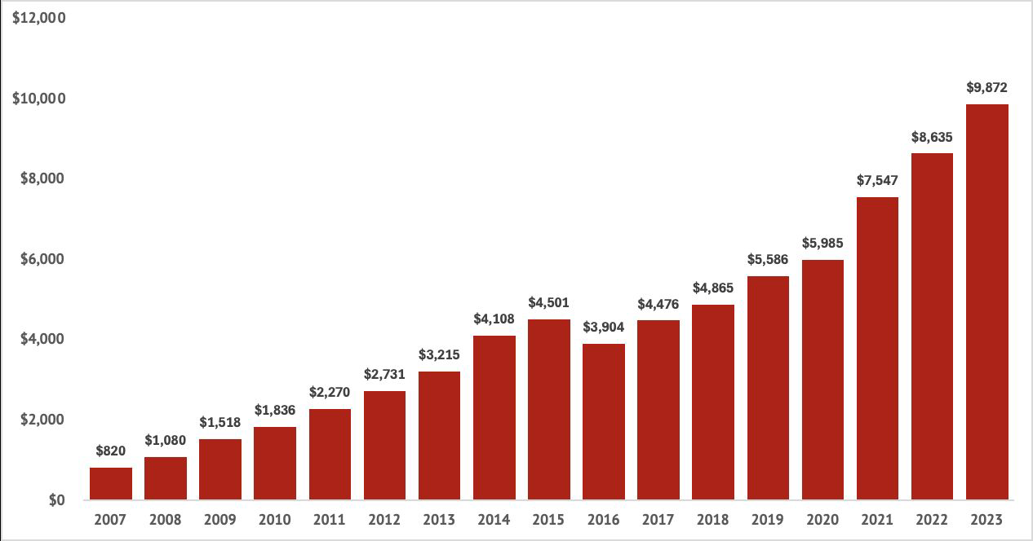
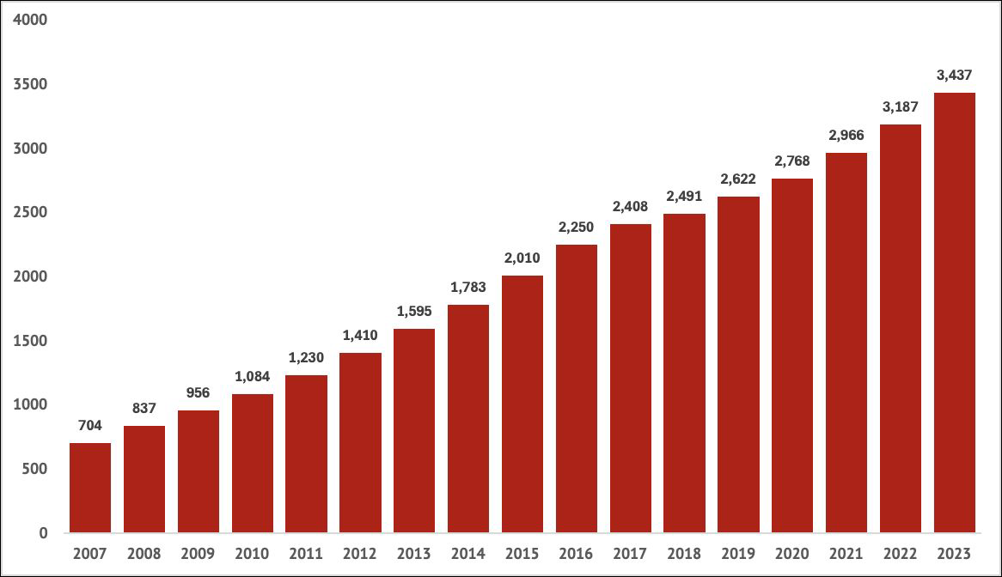

Restaurant Chain’s History
2018
Daily Closing Price of Restaurant Chain (2006 IPO-Present)
Ordered to pay $25mn for role in
E. Coli Crisis
Miss on Earnings
Brian Niccol becomes CEO; HQ moves to Newport Beach, California.
E. Coli Crisis Begins
Launches "Food with Integrity" initiative
Revenue reaches
$2.27B
Opens its 1000 store
Enduring Growth of Revenue
Persistent Increase in Store Count
Revenue in millions of U.S. dollars
Store Count
9

Slide 10
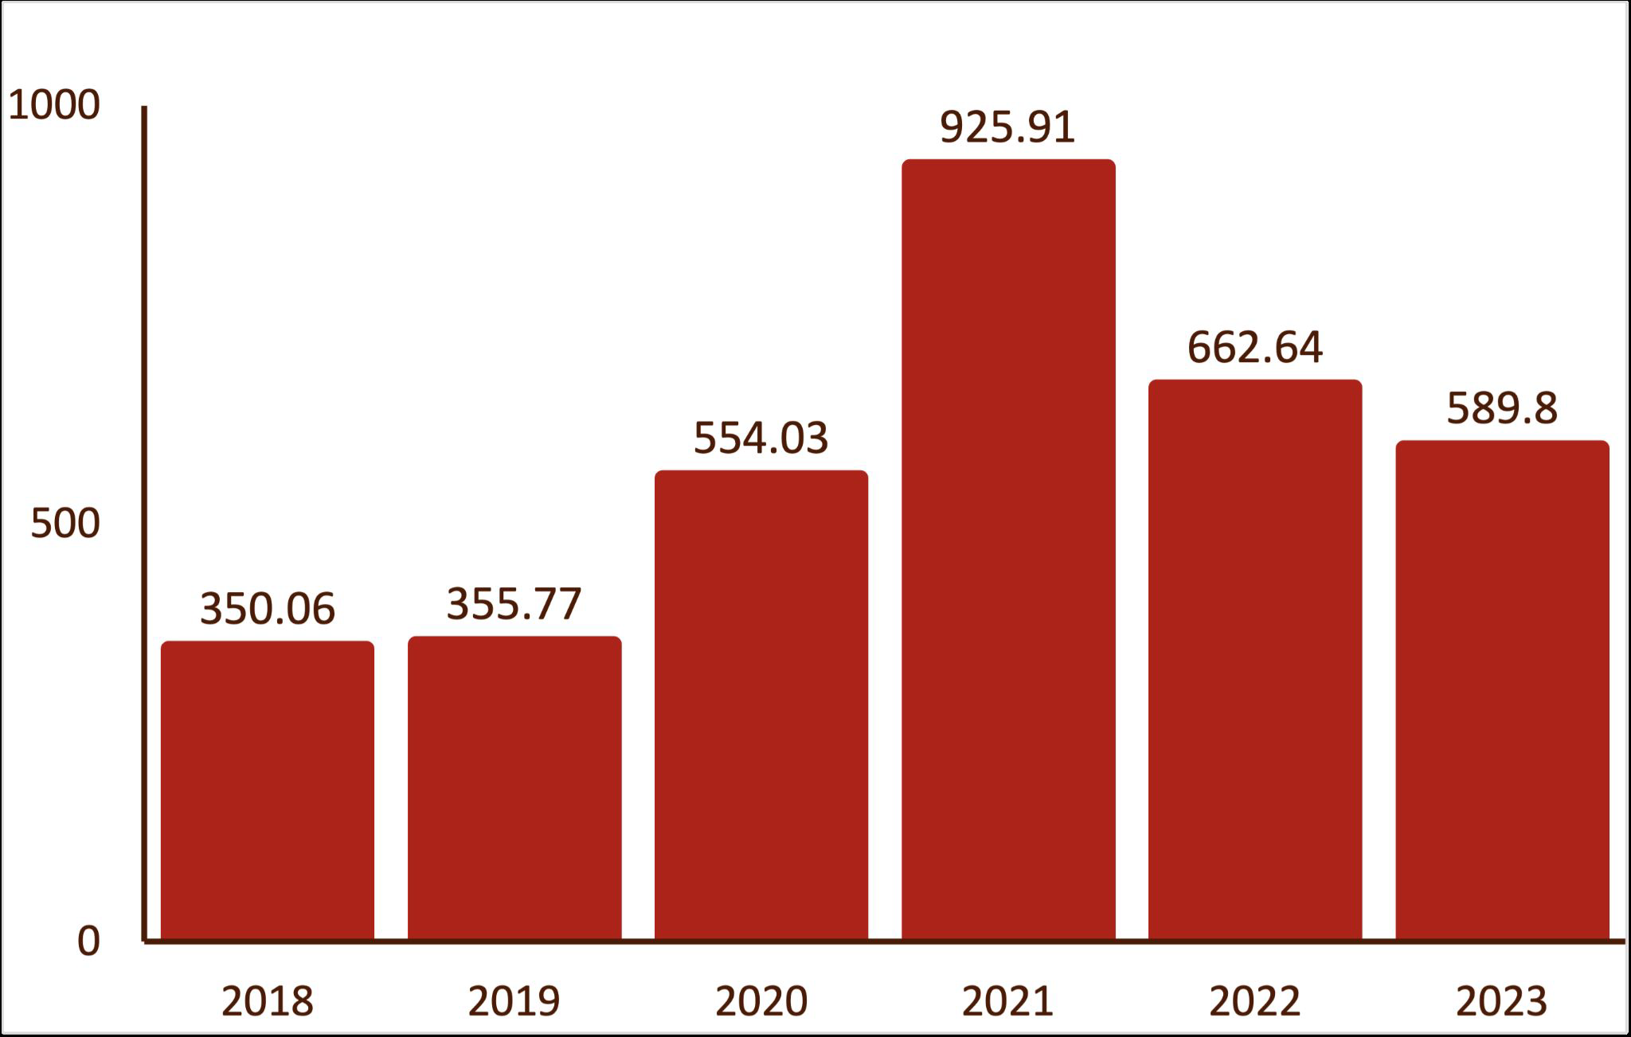
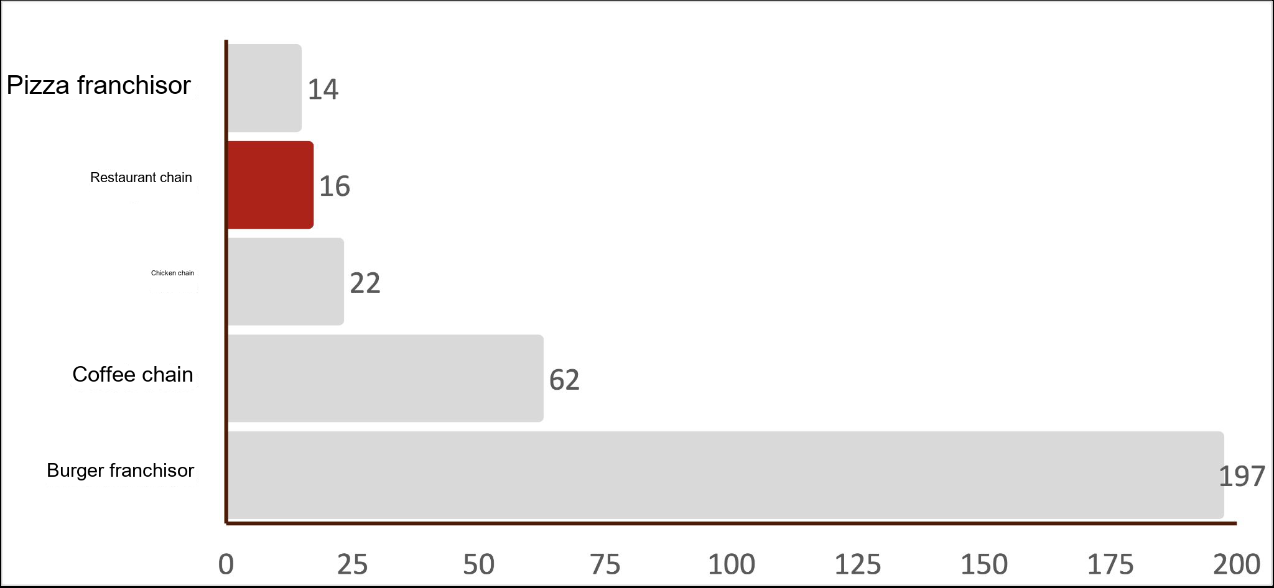
State of Restaurant Chain: Opportunity for M&A
Increasing Focus on Technology
In 2022 Restaurant Chain began Venture fund fund, initially investing $50 million and have since invested an additional $50 million
The Venture fund fund aims to support technologies that Restaurant Chain wishes to integrate into their supply chain or operations
  Autocado, an avocado processing robot, and Chippy, a tortilla chip making robot have been developed but yet to be a proven success and deployed in stores
  Automated makeline continues to be a focus as Restaurant Chain estimates it could build 65% of digital orders, but still remains in the test stages which is estimated to take years
Excess Cash, More Share Buybacks
As Restaurant Chain has obtained a healthy amount of cash, they have dedicated a signiﬁcant portion to share buybacks
Restaurant Chain’s allocation to Share Buybacks
in million U.S. dollars
Moderate Standing in Brand Value
Evergoing Focus on Making a Difference
Pioneering the fast casual industry with a focus on serving just 53 ingredients on their menu and utilizing an assembly line-format, Restaurant Chain aims to continue to redeﬁne the fast food sector
  Desires to continue sourcing all produce from farms within 350 miles of their distribution centers; all produce is organic
  Aims to increase the number of restaurants who
compost by 23% (only ~30% currently compost)
Brand value of the most valuable QSR brands*
in billion U.S. dollars
Footnote: *money generated of branded product vs money generated of the same brandless product
10

Slide 11
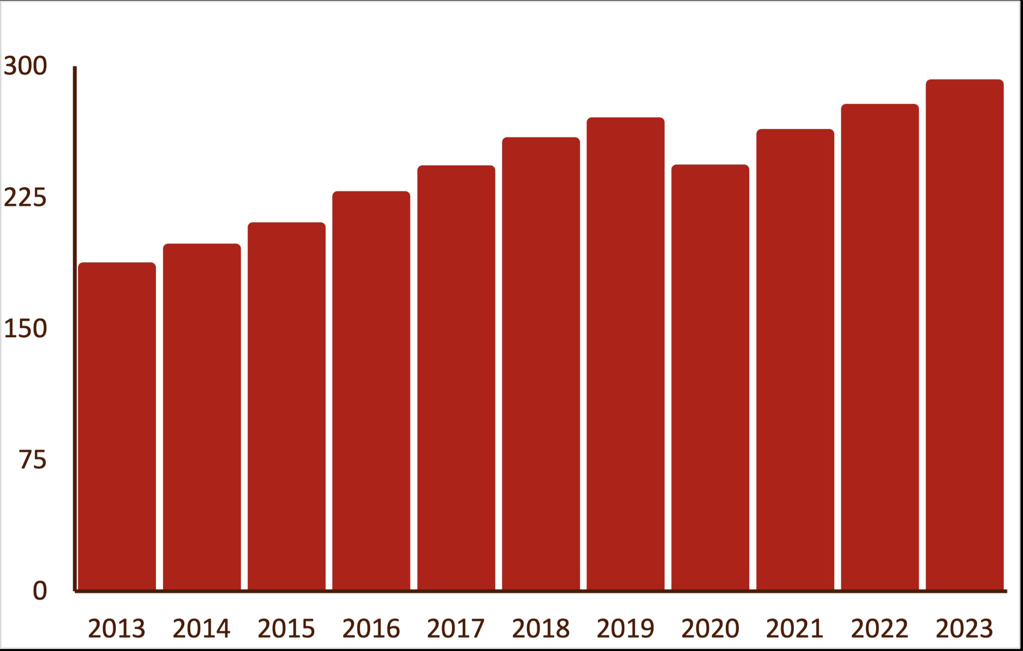
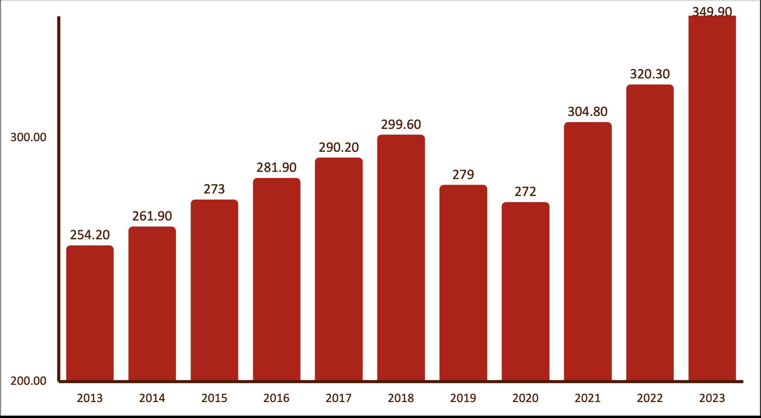
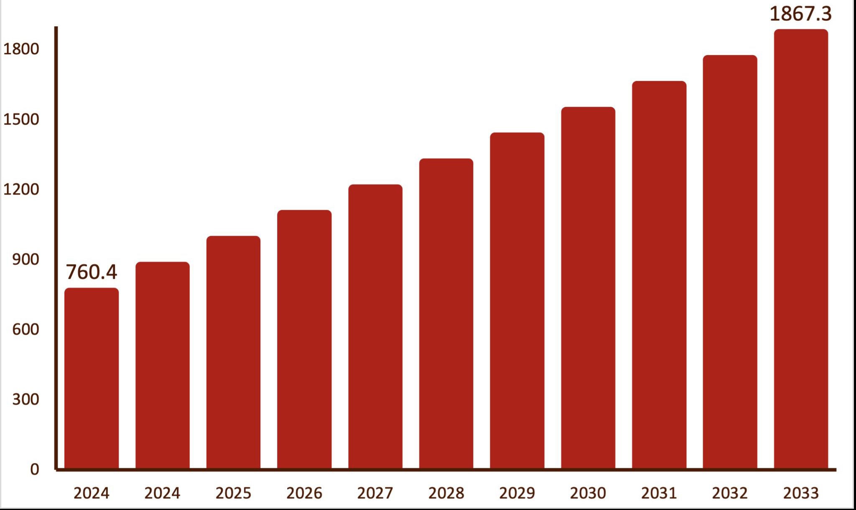
Industry Overview: A New Generation of Taste
The QSR industry can capitalize on growth opportunities by satisfying the increasing consumer demand for healthier dining options
Commitment to Healthy Eating
View Healthy Eating as a Privilege
Inclination to Spend More Through Loyalty
State of the Consumer
42%
of consumers are putting more effort into healthy eating; only 9% state that they are putting less effort
41%
of consumers would be encouraged to spend more on takeout/delivery through restaurant loyalty programs
Affordability ≠ healthy
As consumers fall into more difﬁcult ﬁnancial situations, they increasingly see healthy options as a luxury
Consistent Consumer Spending
Consumer Spending has a persistent upward trajectory pre and post COVID
Stong Outlook Growth
QSR is expected to see a healthy 10-year CAGR +9.4%
Increasingly Competitive Market
Output in the QSR market has increased +63% in the past 10 years
Quick Service Restaurant (QSR) Sector
CAGR +9.4%
U.S. QSR Consumer Spending in billions USD
U.S. QSR Output in billions USD

Slide 12



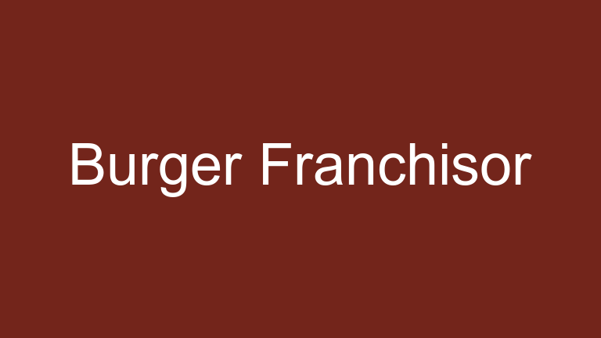

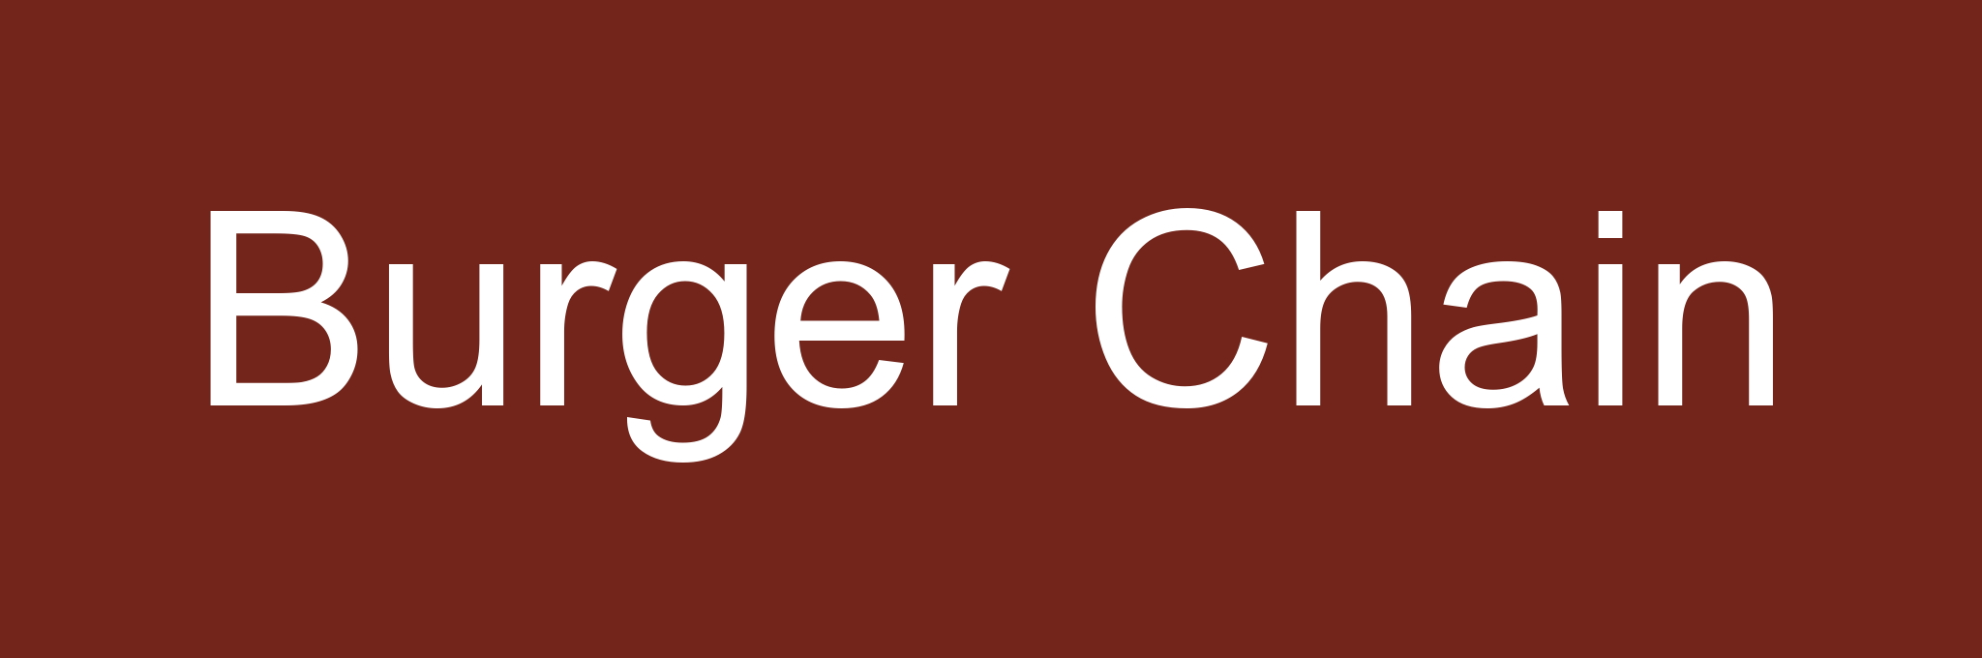
Quick Service Restaurant Market
Qualitative and Quantitative Metrics
Cuisine Year Founded Price
Companies
Number of locations
Health Ranking
3,437
Mexican
1993
$
A
1,017
Salads
2007
$$
N/A
328
Mediterranean
2006
$$
N/A
510*
American: Burgers
2001
$$
B-
38,000+*
American
1940
$
C+
20,591*
American: Pizzas
1960
$
F
7,240
American
1969
$
F

Slide 13
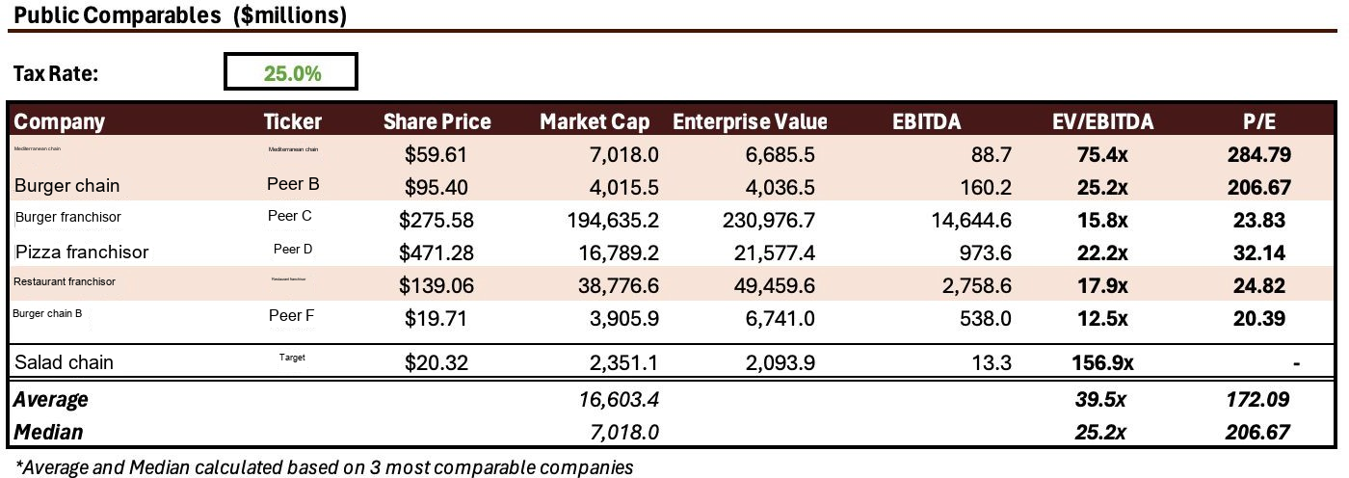
Public Comparables
The fast-casual industry is dominated by Restaurant Chain with incoming players, Mediterranean chain and Salad chain, still in infancy stages. Traditional fast-food is the dominant player in quick-service restaurants.
Salad chain is one of the most highly valued Fast-Casual chains within its comparable set. However, it provides abundant growth opportunities due to its size.

Slide 14
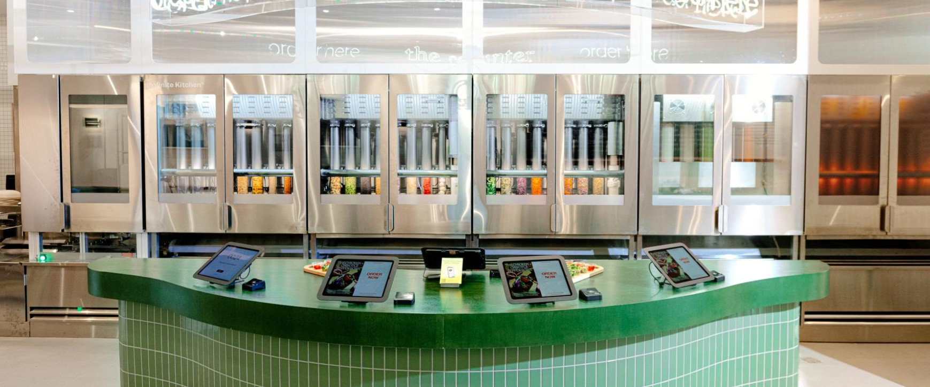
State of Salad Restaurant Chain
New Growth Strategies
As they are still unproﬁtable, they are managing expenses by removing its middle management to streamline their operations while they are investing in head coach training to boost employee retention
CEO Jonathan Neman announced a new conservative growth plan to open 30 vs 35 stores in dense urban areas to best integrate their Inﬁnite Kitchen technology
Aiming to increase connection with customers, Salad chain upgraded their loyalty program and launched the Salad chain pass; charging customers $10 monthly to get
$3 each order
Continual Focus on Ethical Sourcing
Since their founding Salad chain has prided themselves on interacting directly with farmers within their local network to source all of their ingredients
  As Salad chain’s strategy eliminates some of the beneﬁts of scale they have looked to technology to support supplier management as their chain grows they have struggled to ﬁnd the right partners to scale
Established Technological Success: Trailblazing Innovation in the Industry
Spearheading the transition to robotic automation in the quick service industry, Salad chain has launched technology driven stores
After years of development, Salad chain opened their automated Inﬁnite Kitchen in Naperville Illinois in 2023
  Salad chain estimated a 15% decrease in labor costs; lead them to open a second of the same format in the last quarter of 2023 in Huntington Beach, California
Salad chain launched their ﬁrst digital-only location in Washington D.C.
  The new format’s revenue run rate is trending 30% higher than the previous location

Slide 15




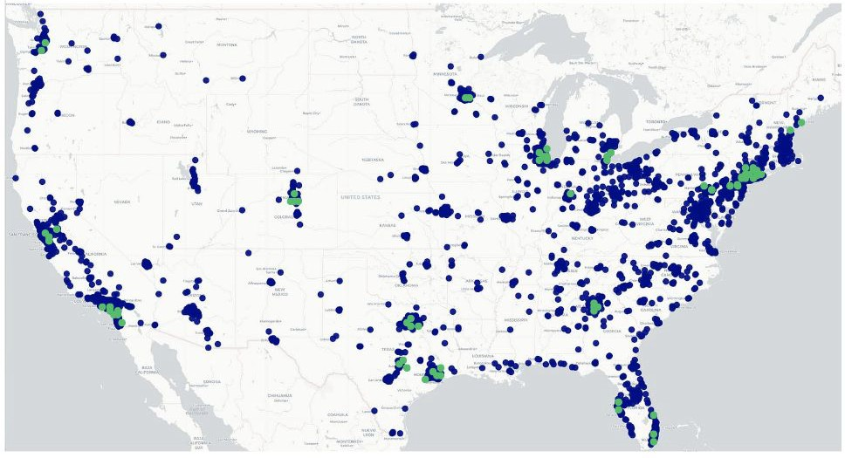
Restaurant Chains: Complementary Capabilities
Restaurant Chain Holding Company presents an opportunity for Salad chain and Restaurant Chain to thrive
Core Companies Chart Company Structure
Restaurant Chain Holding Company
Fast Casual
Sustainable Sourcing
Proven Success in AI implementation
Assembly line business model
Health-Forward focus
Vast Geographic Footprint
Operation competencies
Geographic Map

Slide 16
I. Transaction Highlights
II. Company Backgrounds
III. Strategic Rationale
IV. Value Creation
V. Financial Impact
VI. Risks
VII. Antitrust
VIII. Approach Strategy
Agenda
16

Slide 17
Beneﬁts of M&A: Synergies in Action
An acquisition of Salad chain would beneﬁt both parties as their competencies are synergistic
Cost Synergies
SG&A COGS
10% 7%
We estimate an integration with Restaurant Chain
Based on an analysis of individual store sourcing and local produce available, our research estimates a possible 7% reduction in Salad chain’s COGS over 3 years; supply chain integrations, increased accuracy through assembly line automation, reduction in store stafﬁng
Corporate could help realize a 10% reduction in their current SG&A over 3 years; Salad chain’s SG&A stands sustainably high at 27.9% of revenue while Restaurant Chain's stands at 6.5%. A combined corporate structure will increase efﬁciencies in Salad chains business model.
*Assumptions based on Base Case
17

Slide 18
Beneﬁts of M&A: Synergies in Action
Revenue synergies provide a possible avenue for growth while Tax synergies will reduce Restaurant Chain’s tax burden by 32% for the following year.
1%
$192mm
Loyalty programs are staples across the entire quick service industry and present a opportunity to for revenue growth based on a core set of customers
A combined loyalty program opens opportunity for cross-selling
Revenue Synergies
Salad chain has been operating at a Net Income Loss based on publicly available ﬁnancial data. They have accumulated $749.67M in NOLs
Tax Synergies
These NOLs could provide the Restaurant Chain Holding Company a $192M reduction in taxes in the next ﬁscal year
Revenue Synergies have not been assumed in any following valuation work. We have taken a conservative approach do not see these savings are guarantees.
18

Slide 19
I. Transaction Highlights
II. Company Backgrounds
III. Strategic Rationale
IV. Value Creation
V. Financial Impact
VI. Risks
VII. Antitrust
VIII. Approach Strategy
Agenda
VI. VII. VIII.
19

Slide 20
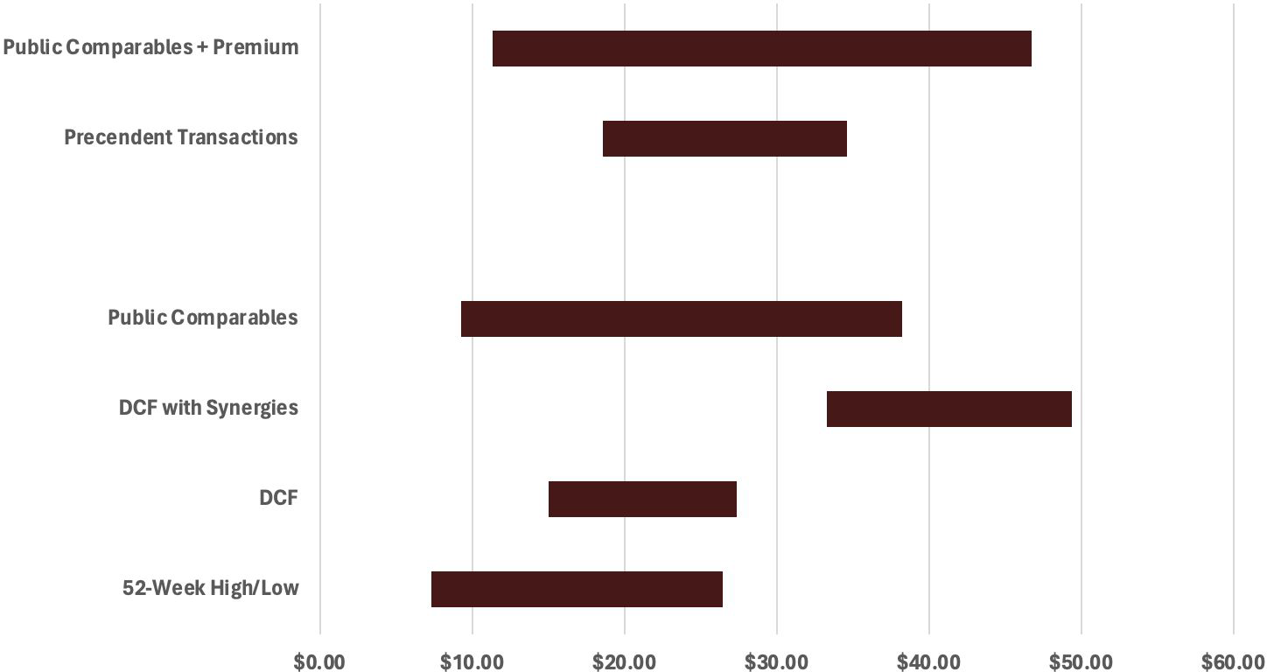
Valuation Football Field
Salad chain’s current* share price is $20.32, a max offer price of 27.88% represents a 37% control premium
Opening Offer $25.71 Max Offer $27.88
Control
Premium
Price/Revenue
$11.37
$46.75
$18.61
$34.64
Price/Revenue
No Control Premium
$9.30
$38.25
Price/Revenue
Intrinsic
$33.32
$49.38
$15.03
$27.39
Intrinsic
$7.35
$26.45
*These values are based on a range of sensitivity analysis and include only relevant comparables
Footnote: *9:30 am 4/23/2024
20

Slide 21
I. Transaction Highlights
II. Company Backgrounds
III. Strategic Rationale
IV. Value Creation
V. Financial Impact
VI. Risks
VII. Antitrust
VIII. Approach Strategy
Agenda
VII. VIII.
21

Slide 22
Risks
An acquisition of Salad chain stands to defy risks as the companies’ complement each other
Risk: Restaurant Chain’s history of organic growth vs through M&A may present integration friction.
Mitigant: Salad chain and Restaurant Chain have acquired firms for R&D advancements successfully. Utilizing the same framework in this acquisition while benefiting from their shared business model increases the probability of success.
Restaurant Chain’s M&A Track Record
Risk: Both Salad chain and Restaurant Chain targets health-conscious consumers seeking an alternative to fast-food options; customers may choose to frequent just one of the restaurants as they combine.
Mitigant: By creating the Restaurant Chain Holding Company, Restaurant Chain and Salad chain are able to stand independent to the customer. They each will keep their core differentiators in cuisine and aesthetics, giving the customer differentiated experiences.
Risks
Cannibalism
Risk: Labor cost are core elements of both Salad chain and Restaurant Chain’s operations. As labor costs rise (compensation costs for private industry
+4.3% YoY), their gross margins risk being eaten away.
Mitigant: Implementation of automation for food assembly lines across both restaurants reduce the quantity of staff needed at any given shift
Increasing Labor Cost
22

Slide 23
I. Transaction Highlights
II. Company Backgrounds
III. Strategic Rationale
IV. Value Creation
V. Financial Impact
VI. Risks
VII. Antitrust
VIII. Approach Strategy
Agenda
23

Slide 24
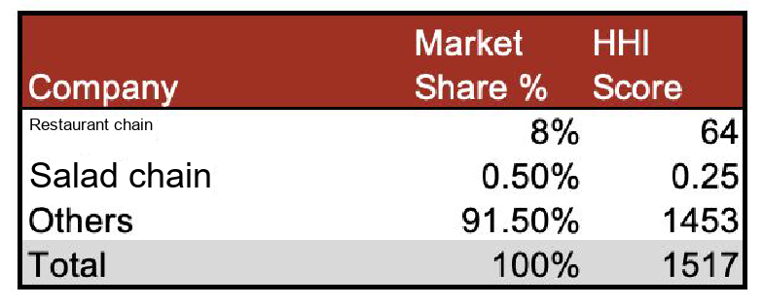
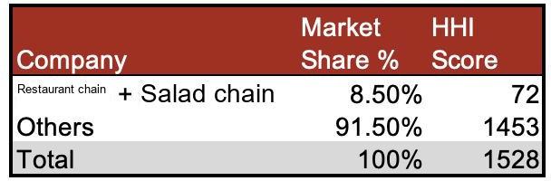
Antitrust
Our analysis of competitors took into account only 12 of most prominent quick-service restaurants, making our analysis heavily conservative for the potential acquisition.
Pre-Merger HHI
Post-Merger HHI
A post-acquisition HHI score of 72 reﬂects a highly fragmented industry with SEC antitrust regulations being of next to no concern.
24

Slide 25
I. Transaction Highlights
II. Company Backgrounds
III. Strategic Rationale
IV. Value Creation
V. Financial Impact
VI. Risks
VII. Antitrust
VIII. Approach Strategy
Agenda
25

Slide 26
Strategy Approach: Prioritizing Integration
M&A Goal
Strategy
Create a smooth integration between Restaurant Chain and Salad chain to maximize effects between the supply chain and corporate structure
Enabling strategic growth through 'bear hug' collaboration, fostering shareholder value and operational synergy without resistance.
We recommend Restaurant Chain hold off on executing this transaction for ~1 year. Due the impact of the unideal credit market conditions on the debt ﬁnancing incurred and Salad chain’s high valuation.

Slide 27
Q&A

Slide 28
Appendix

Slide 29
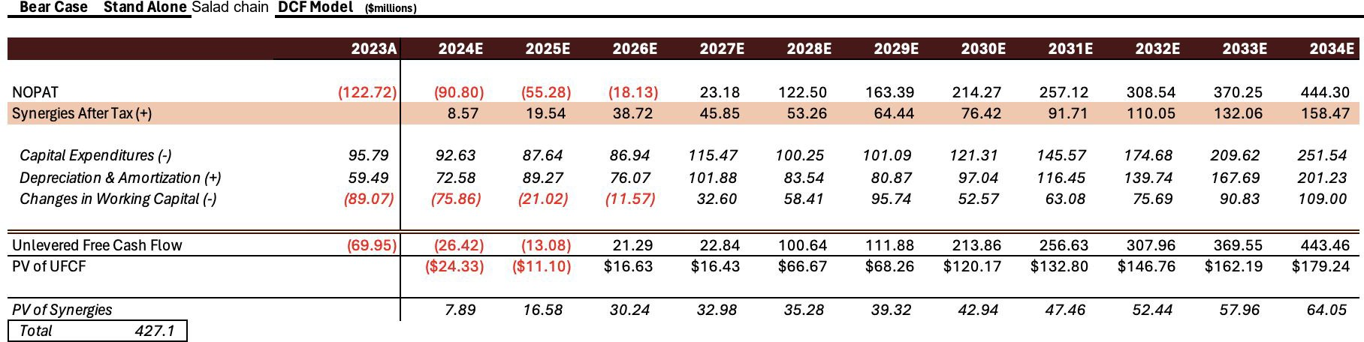
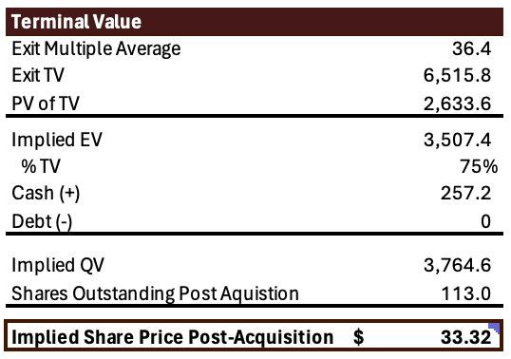
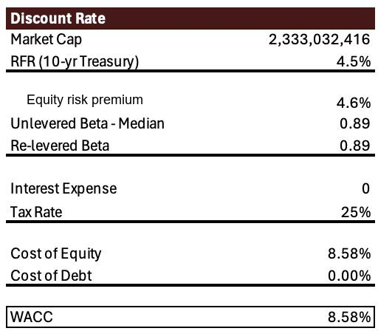
Bear Case Stand Alone Salad chain DCF

Slide 30
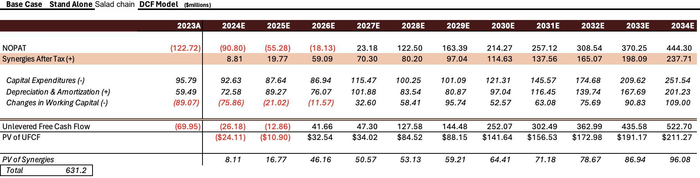
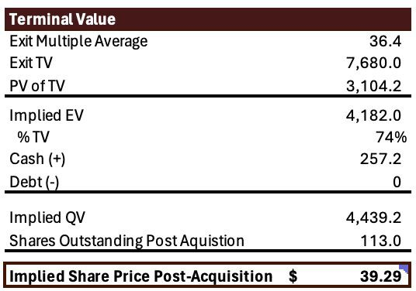
Base Case Stand Alone Salad chain DCF

Slide 31
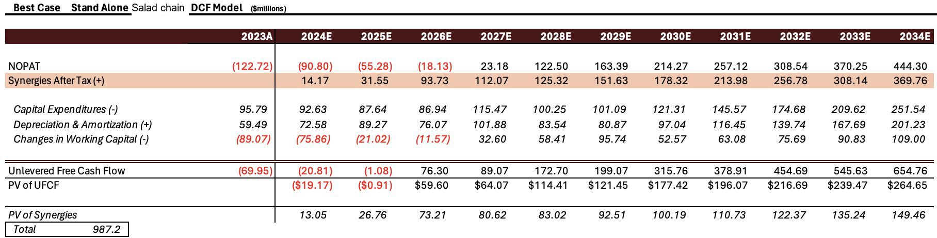

Best Case Stand Alone Salad chain DCF

Slide 32
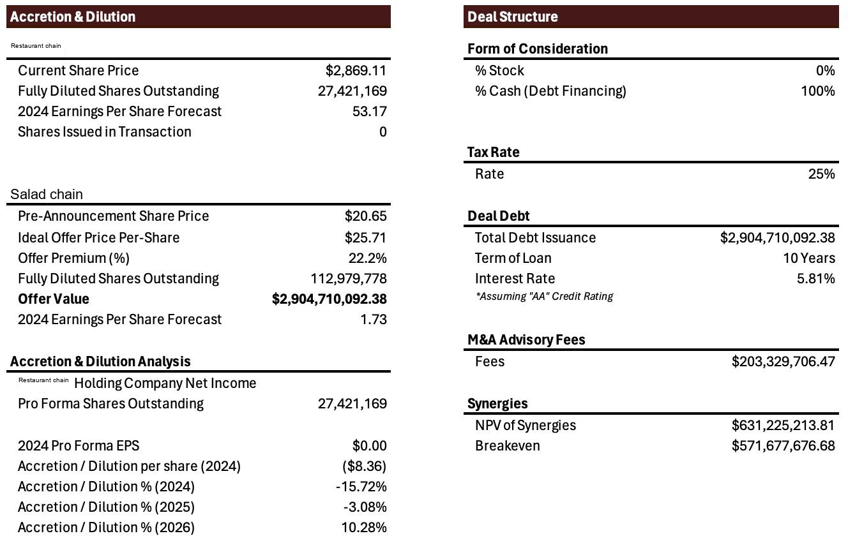
Accretion/Dilution & Deal Structure

Slide 33
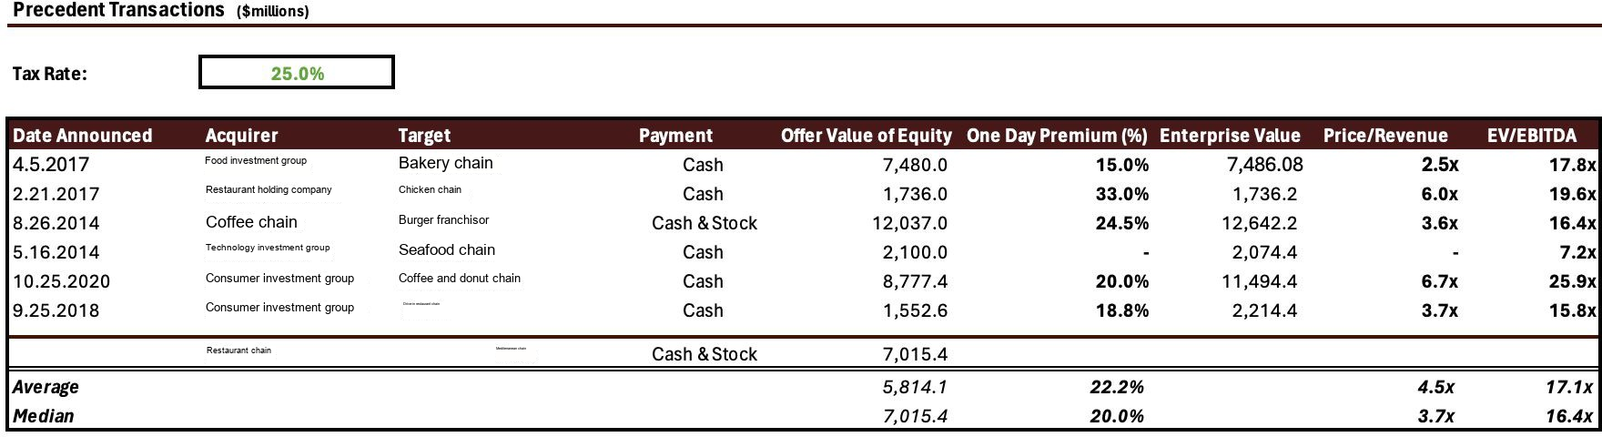
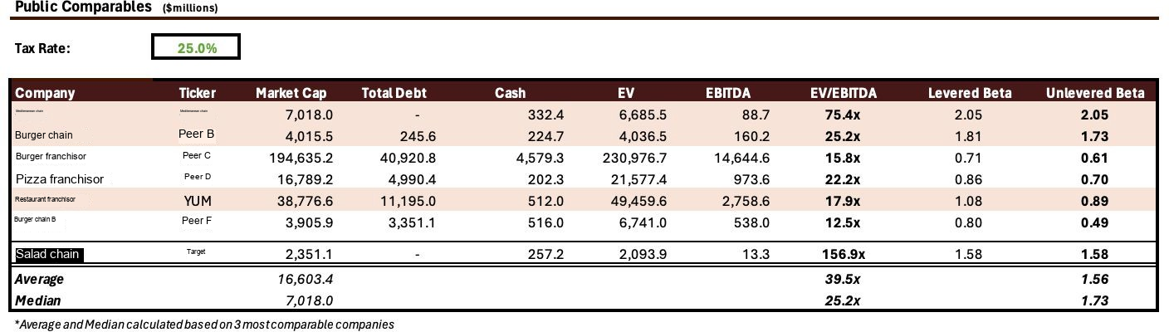
Precedent Transactions & Public Comparables

Slide 34
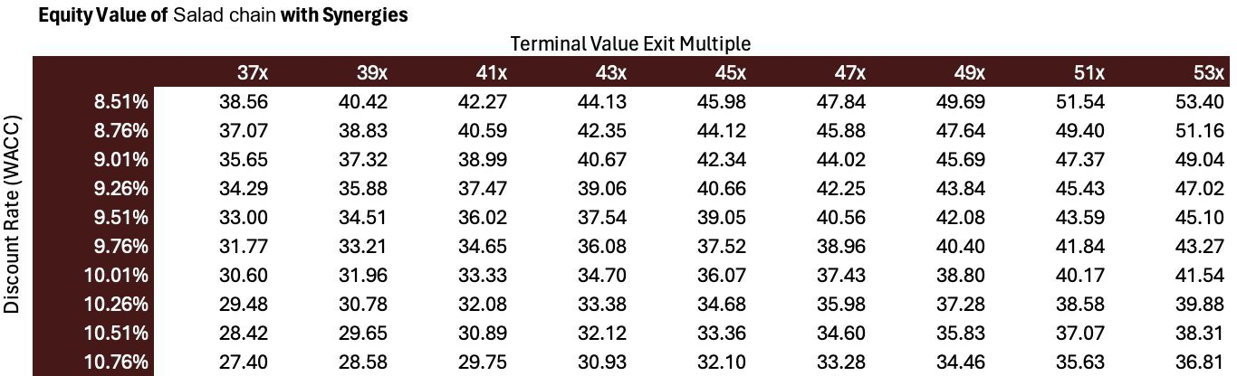
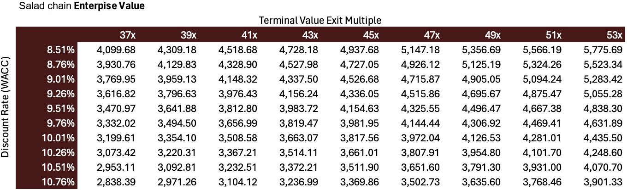
Sensitivity Analysis

Slide 35
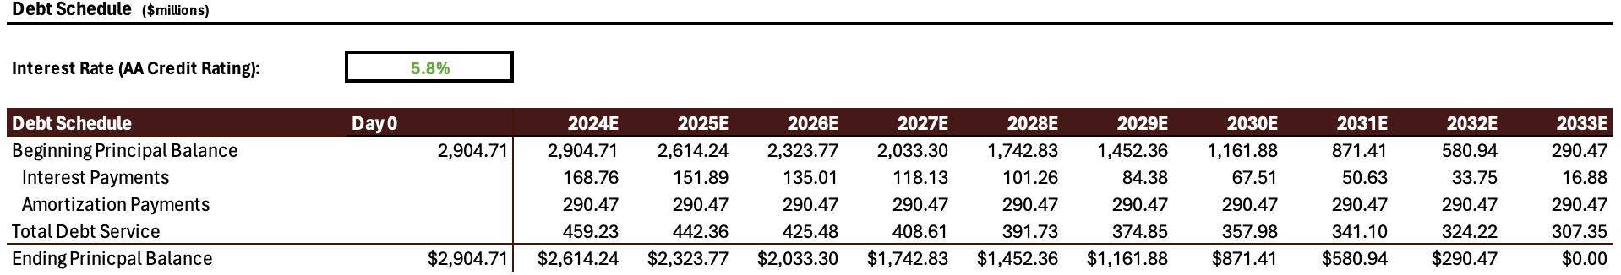
Debt Schedule For Restaurant Chain

Slide 36
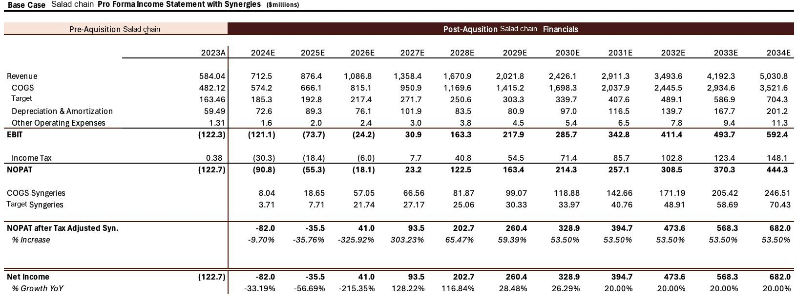
Income Statement Pro Forma

Slide 37
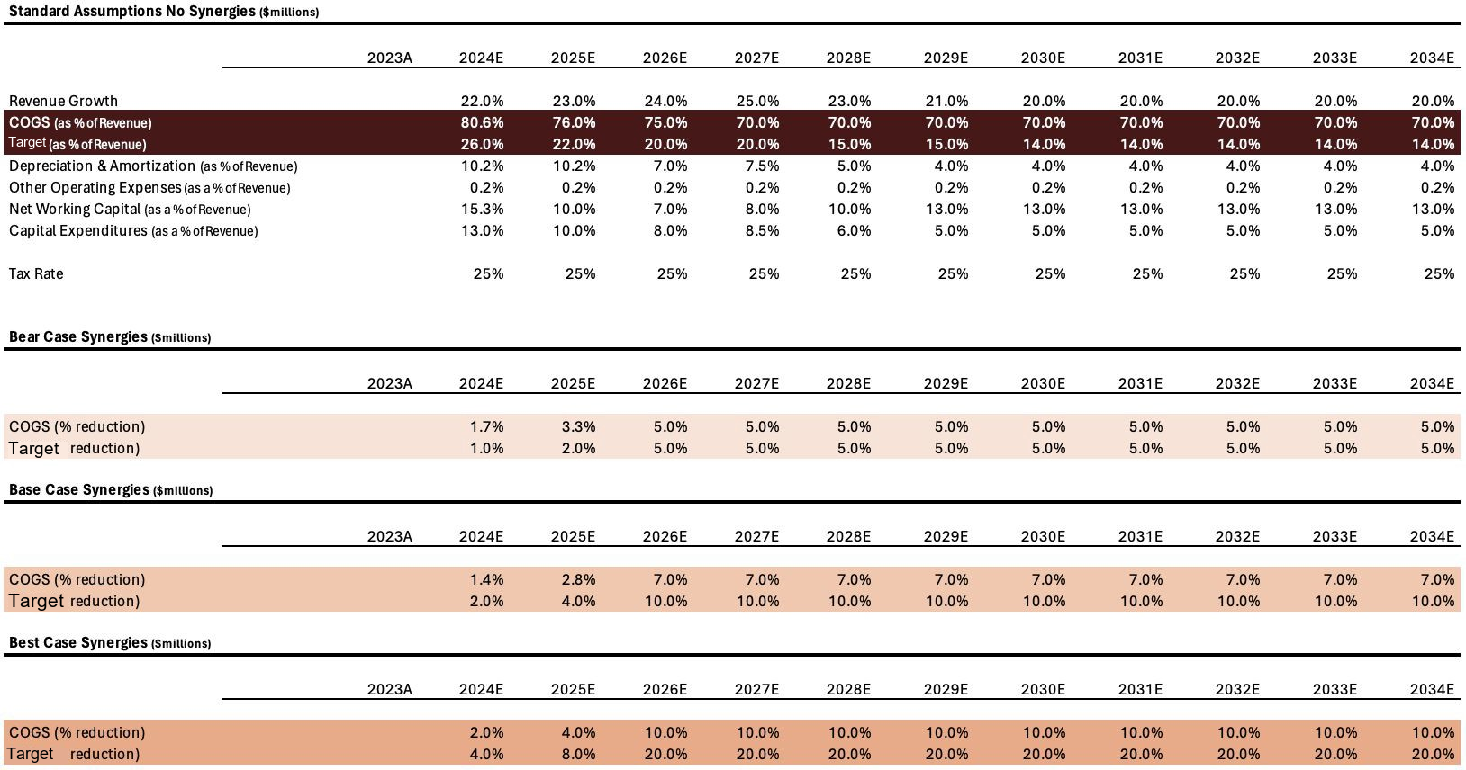
Assumptions

Slide 38
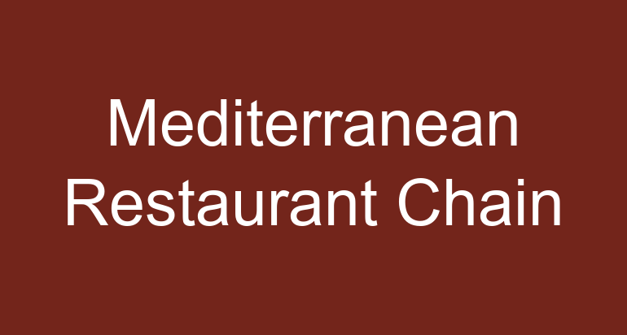
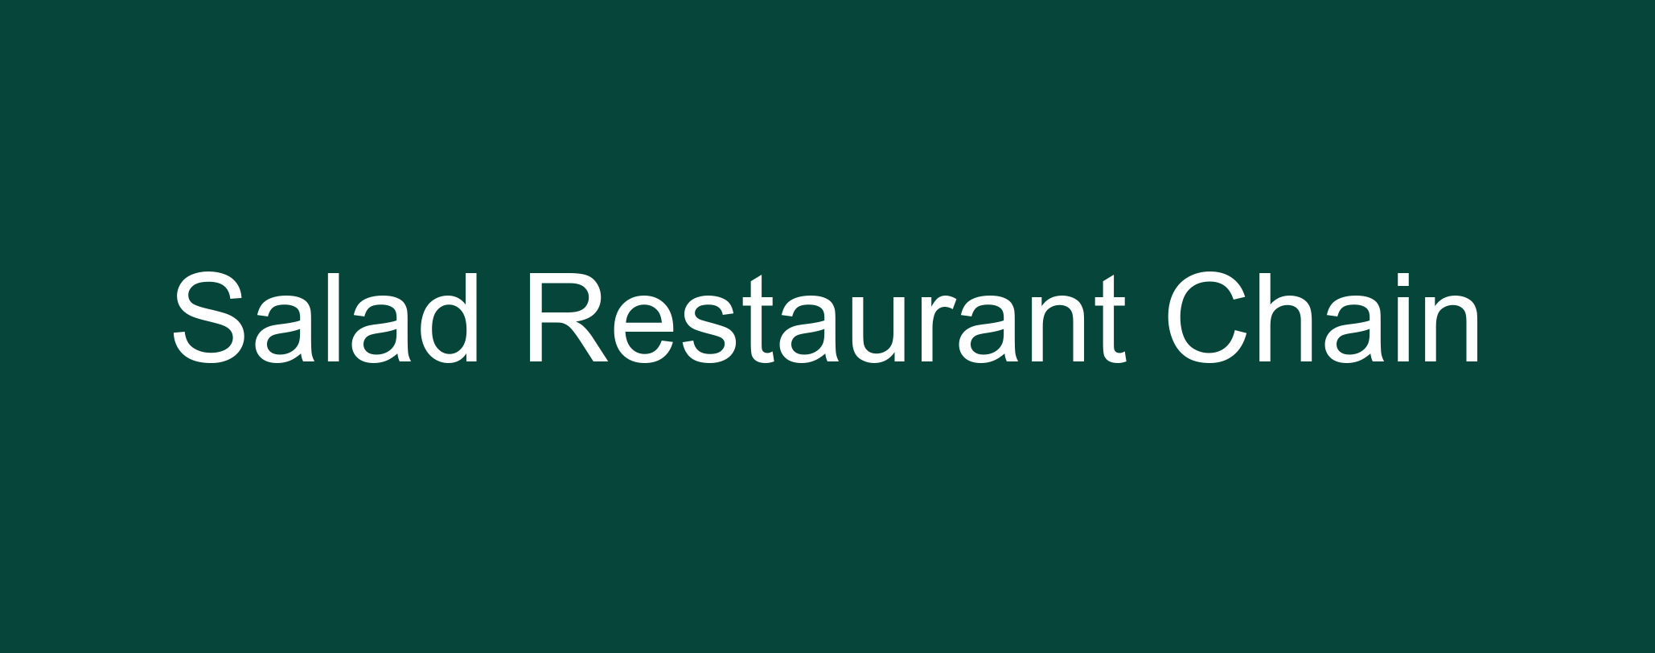
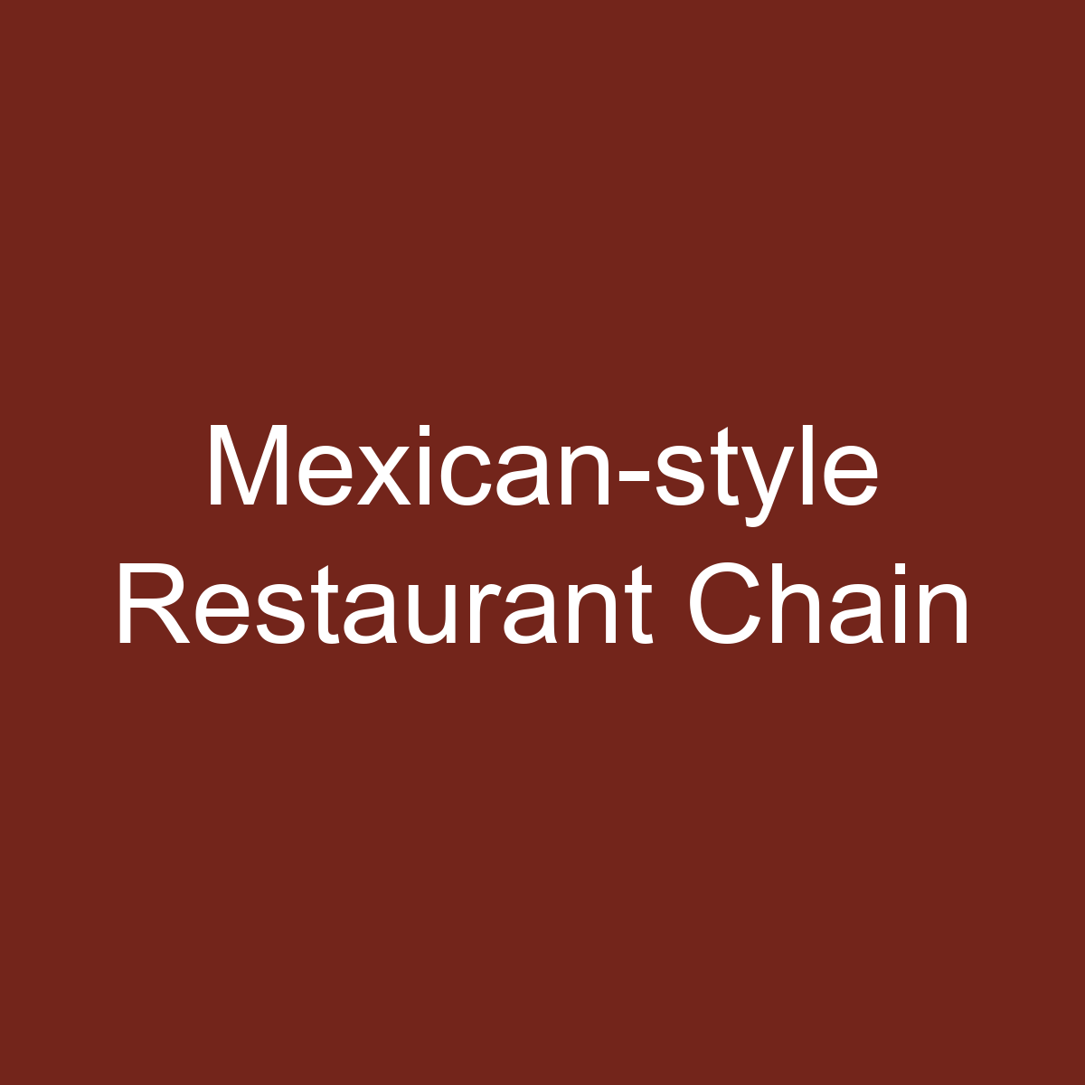
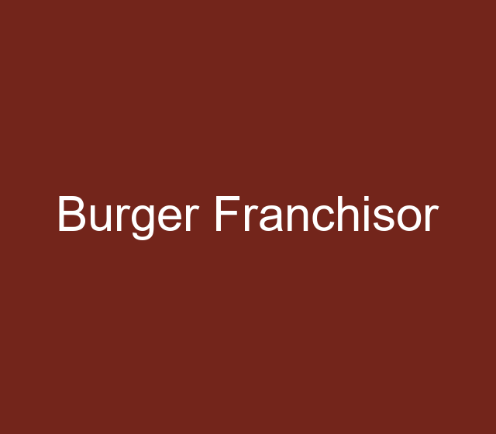
Restaurant Chain’s Timeline
Founded
Founded
2005 2006
Opens its Goes public 500 store (IPO) at
$22/share
Founded
1998
2001
2007
2010 2011
Opens its Revenue 1000 reaches
2015
2018 2020
Brian Niccol Ordered to becomes CEO; pay $25mn HQ moves to for role in Newport Beach, E. Coli
California.
2023
Disrupts the fast food market with their assembly line and vast focus on ingredients
Burger franchisor invests
$360mn+
E.Coli Crisis Begins
store
$2.27
Billion

Slide 39
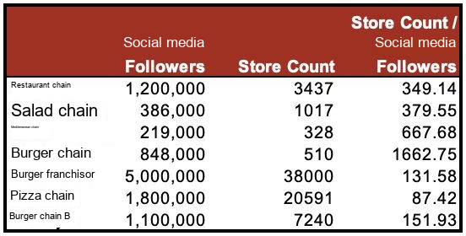
Instagram Followers: Store Count

Slide 40
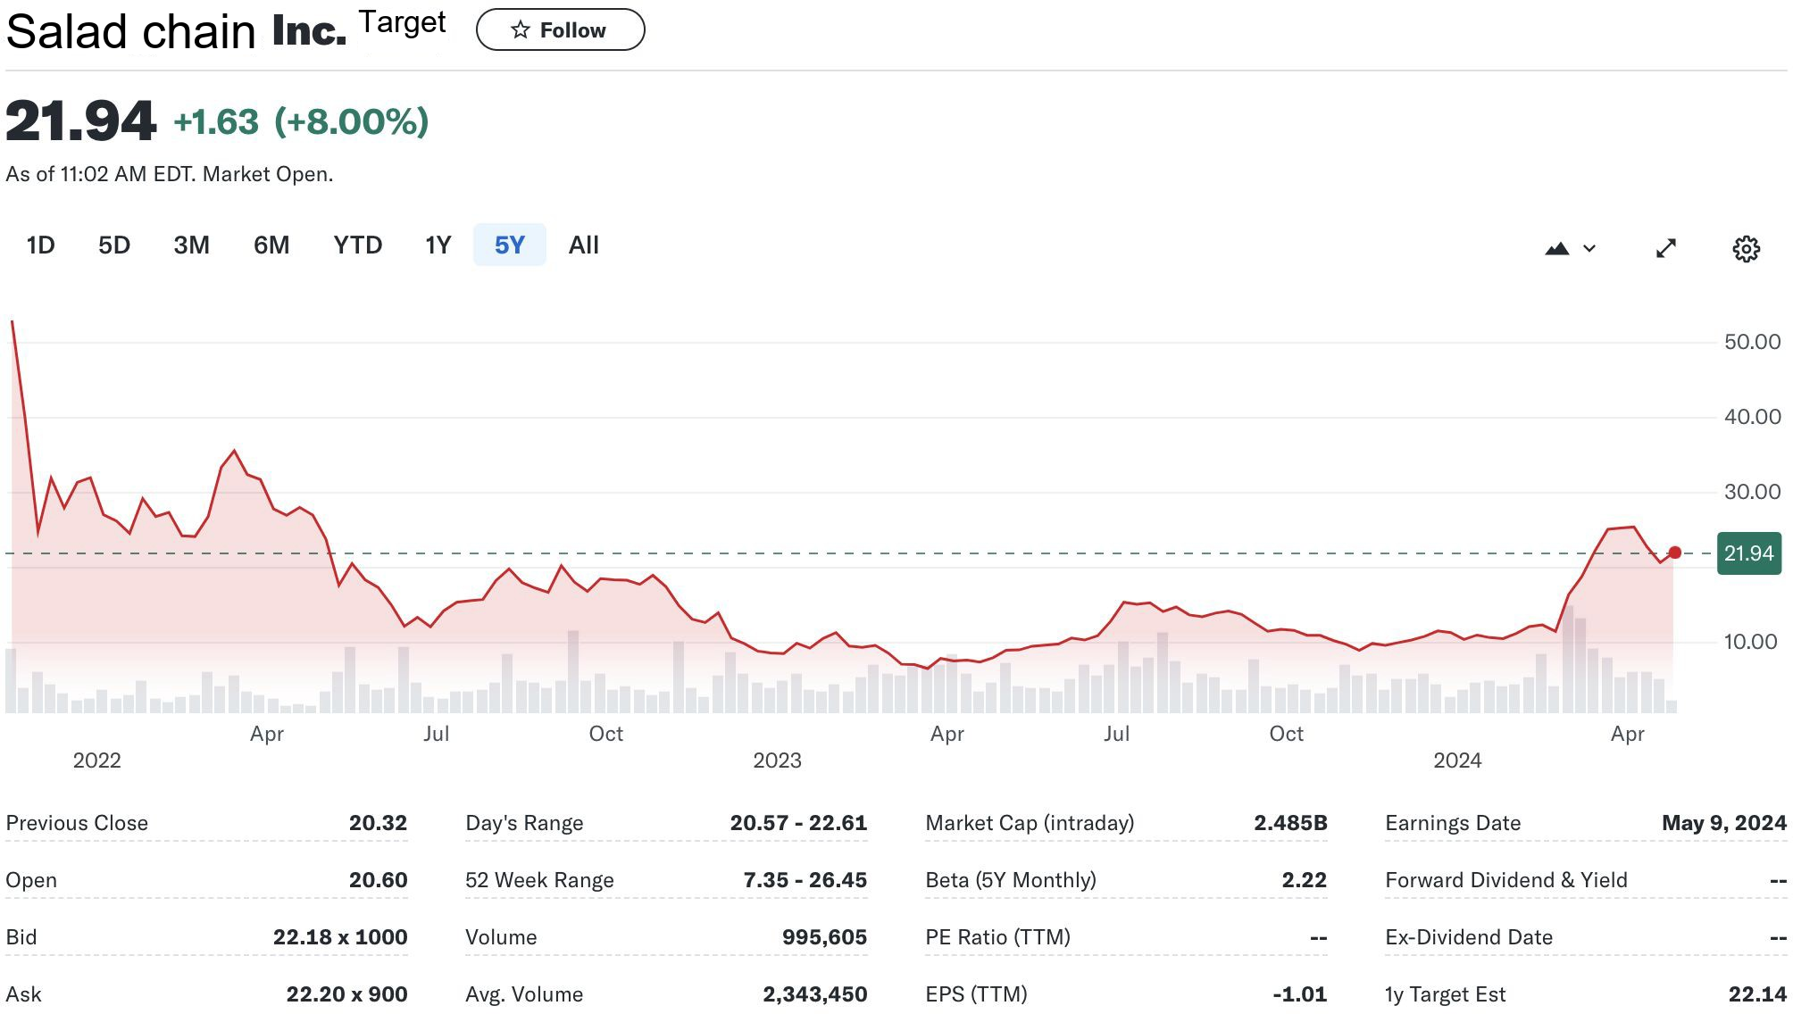
Salad chain Stock

Slide 41
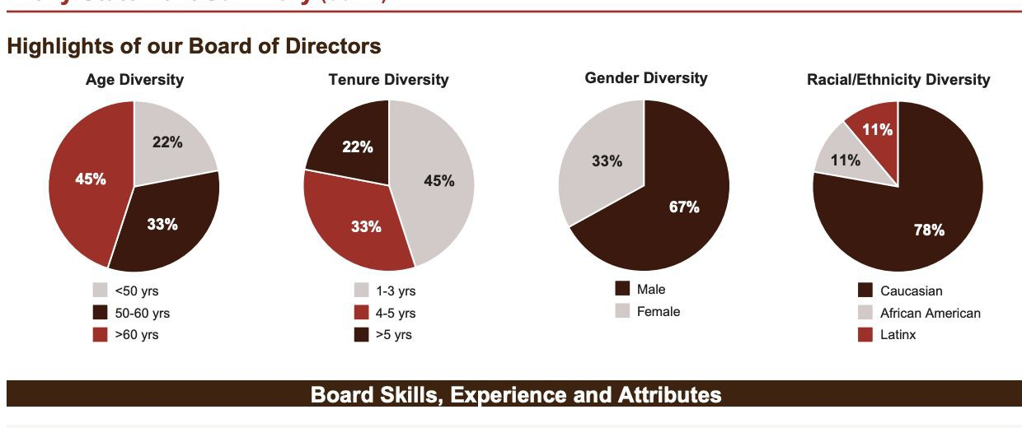

Governance Profile
Board composition
Director skill mix
Oversight priorities

Slide 42
Transaction Diligence and Monitoring
Execution diligence
Confirm customer proposition and brand separation.
Test revenue recognition and recurring cost classification.
Reconcile consideration, debt funding and fees.
Validate integration costs before counting savings.
Review competition and regulatory assumptions.
Preserve an independent downside case.
Monitoring priorities
Track same-store growth and restaurant openings.
Compare labor and food costs with the forecast.
Monitor debt service and cash conversion.
Test whether operating savings reach cash flow.
Reassess valuation after changes in rates or margins.
Pause execution if financing or integration conditions weaken.

Slide 43
Multi-brand Operating Lessons
Brand separation
Maintain distinct customer propositions, menus and service formats. A combined owner should avoid treating different restaurant concepts as interchangeable.
Shared capabilities
Procurement, finance, property planning and technology can support operating leverage when integration costs and execution requirements are included.
Underwriting discipline
Keep proposed savings separate from reported results. Test staffing, rollout timing and customer response before assigning value to a combined platform.

Slide 44
Restaurant Business Models
Selected business descriptions. Comparable annual revenue is unavailable in this historical exhibit.
Public
Private
Revenues (Annual 2023)
Restaurant Chain Mexican Grill
Private burger chain
Multi-brand restaurant group
Restaurant investment group
Multi-brand restaurant operator
Restaurant investment group
Private chicken restaurant chain
Global restaurant franchisor
Chicken restaurant franchisor
44

Slide 45
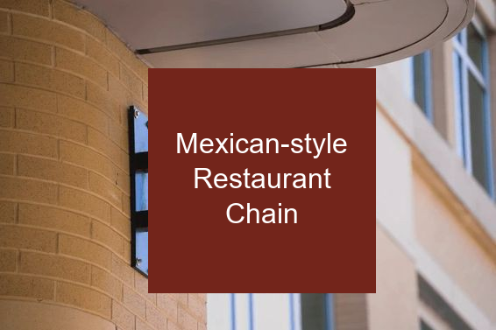
Restaurant Chain’s Company Overview
Business Description:
Restaurant Chain Mexican Grill is a mexican fast-casual food chain specializing in fresh high quality ingredients and customizable meals.
At a glance:
  As of April 2024, Restaurant Chain currently has 3,398 restaurants across the 49 states.
  Founded in 1993 in Denver Colorado, Restaurant Chain has relocated its headquarters to Newport Beach, California.
  Restaurant Chain own and operate all their locations and does not utilize a franchise model (focused on internal growth).
  Restaurant Chain’s initial public offering was at $22 price per share with nearly 8 million shares with Restaurant Chain closing price being $44.00, a 100% increase.
  Restaurant Chain focuses on internal growth, owning and operating all their restaurants.
. Financial Summary
Share Price | $ 2,869.11
52 Week Range | $ 1,768.64 - 3,023.98
Total Debt | $ 4.05B
Cash | $ 1.3B
Market Cap | $ 78.67B
Revenue LTM | $ 9.87B
NOSH | 27.55 M

Slide 46

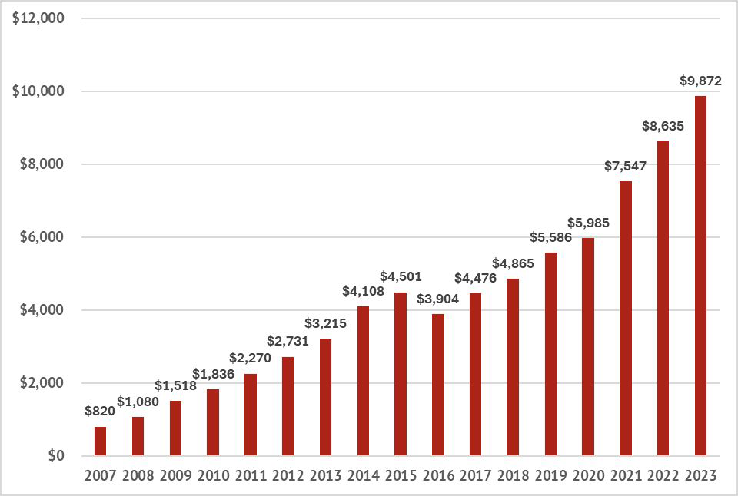
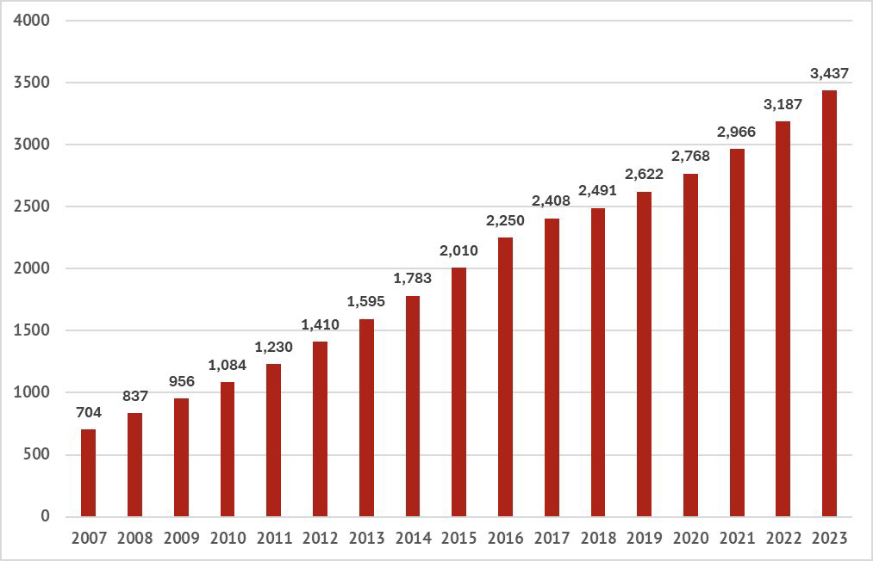
Restaurant Chain’s Timeline
Restaurant Chain's $50 million venture fund invest in early stage companies that align with cultivate next, a campaign that aims to improve operating efficiency and food with integrity mission.
2023
MCDONALD’s Invest in Restaurant Chain
2006: Restaurant Chain goes public (IPO)
Restaurant Chain’s Revenue reached $
2.27 Billion
2001
2007
1998
2005
2006
2007
2011
2018
2024
Burger franchisor had a 90% stake in Restaurant Chain's business.
Burger franchisor had invested approximately $360 million into Restaurant Chain, and took out
$1.5 billion by 2006.
2006
Restaurant Chain owns and operate 704 restaurants across the states
Brian Niccol is named CEO of Restaurant Chain, and the company relocates its headquarters to Newport Beach, California.
Restaurant Chain’s market capitalization is now
$78.67N with over 3350 restaurants.
1993:Steve Ells opens the first Restaurant Chain in Denver, Colorado using an $85,000 loan from his father.
Restaurant Chain’s Revenue ($mm)
Numbers of Restaurant Chain’s Restaurant by Year

Slide 47
Industry Overview: Market Opportunities
Customer demand
Health-oriented and convenient meals provide a possible growth channel. Store productivity and repeat purchases determine whether demand translates into economic returns.
Operating opportunities
Automation and shared sourcing may improve throughput and unit costs. Include implementation costs, training and operating disruption in the case.
Decision conditions
Require financing capacity and evidence of cash-generating operating improvements. Preserve separate brands and monitor labor, food costs and debt service after integration.

