Slide 1


Team US and Canada
, Eshan Mukherjee, ,
What Happened This Week
&
The Prediction on How Fed Rate Will Affect Our Stocks

Slide 2
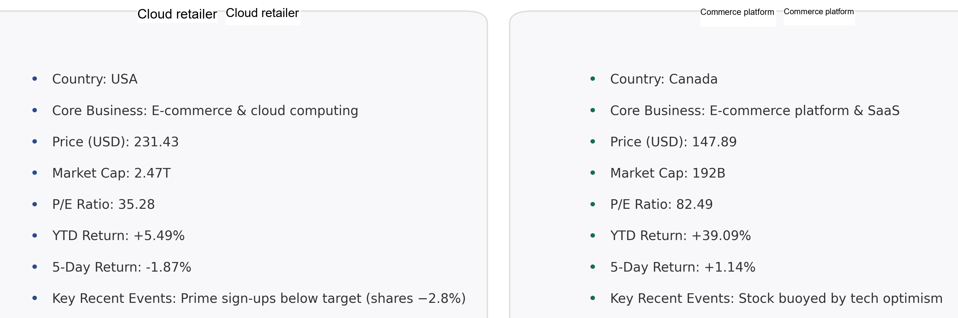
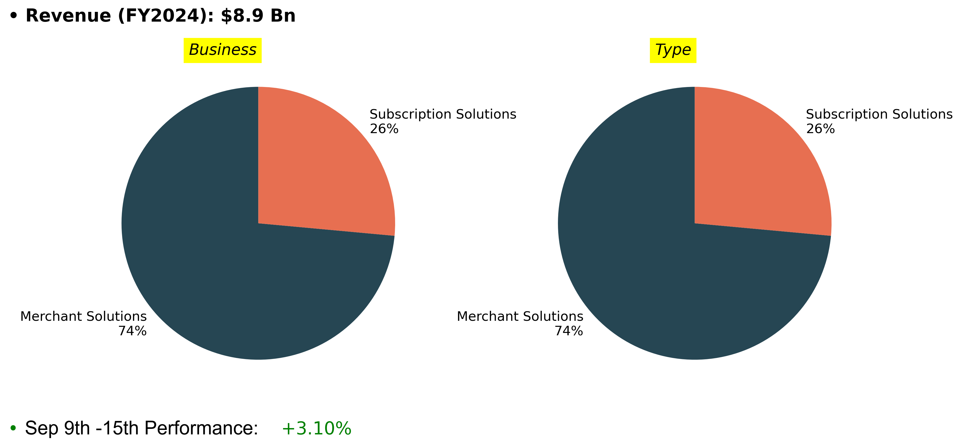
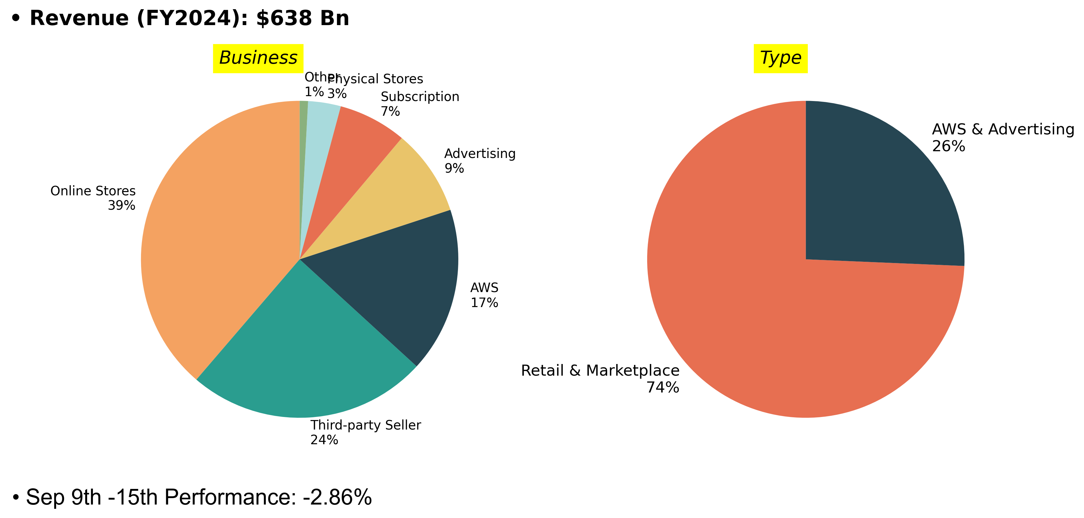
Financials
Cloud and Retail Business Revenue Sources
Commerce Software Platform Revenue Sources​

Slide 3
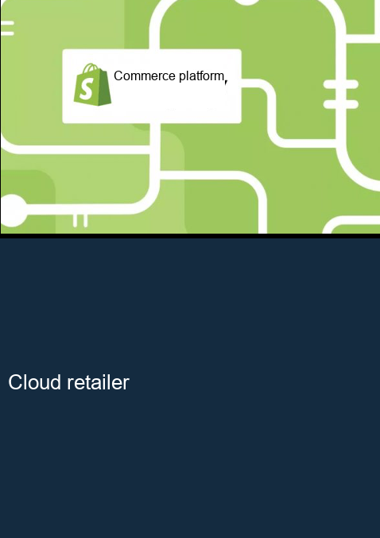
News and Future Outlooks
Commerce Software Platform​
strategic alliance with ESW -->Increased stock priceby +3%. ​
Tech stocks surged due to hopes of Fed cuts whichboosted Commerce Software Platform stock by approximately 3.8% a fewweeks ago. ​
Future Outlooks​
Any update on its Commerce Software Platform FulfillmentNetwork integration (post-Cloud and Retail Business Buywith Primepartnership last year)could be market-moving ifannounced​
U.S. jobs data (early Oct) andconsumer confidence influence rateexpectations and retail health any move in theBank of Canada’s policy can affect investorsentiment.
Cloud and Retail Business
Cloud and Retail Business’s stock is a top pick at Investment Bank----more customers will like to invest in "Investment Bank Top Pick"
Future Outlooks
Cloud and Retail Business announces its fall hardware event----Could generate short-term investor optimism.
Cloud and Retail Business in has launched its “Early Deals” ahead of the Great Indian Festival 2025, starting September 13. Prime members get exclusive early access from September 23----Cheapest Smart Phone and increase revenue
Developing Consumer AR Glasses (“Jayhawk”)-----investors might think there will high RD costs and risks

Slide 4
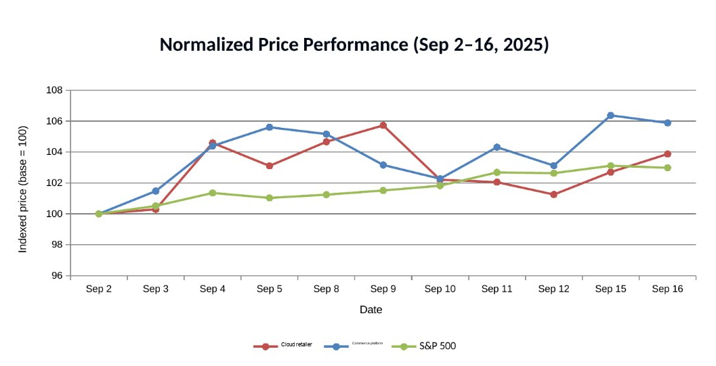
Price Chart
Figure: Cloud and Retail Business (AMZN) and Commerce Software Platform (SHOP) stock prices vs. S&P 500 index, normalizedto 100 on Sep 2, 2025. Over this period, Commerce Software Platform (+~6%) led gains, Cloud and Retail Business rose ~4%,and the S&P 500 gained ~3%.​

Slide 5
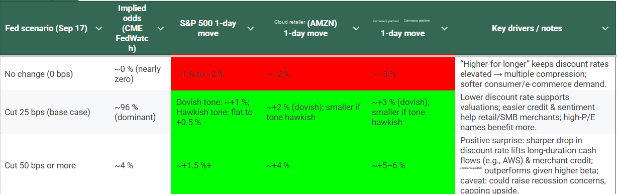
Weighted Scenario Analysis and stock price change
Weighted Scenario Analysis:
Expected Rate Move = (0*0)+(96.1%*25) + (3.9%*50) = 26%
So markets are effectively pricing in an expected 26 bps cut.
(Probabilities from CME FedWatch; snapshot time-stamped; intraday updates may change.)​
Method on how FedWatch derives %s: 30-Day Fed Funds (ZQ) futures price the average effective rate for the month → mapped into probabilities for each 25-bp target range → those %s are used as scenario weights.
Why this matters: The 26 bps single number collapses policy uncertainty into a priced input you can plug into valuation, risk, and position-sizing for Commerce Software Platform (SHOP) and Cloud and Retail Business (AMZN).
375-400 | 3.9%
400-425 | 96.1%
425-450 (Current) | 0.0%

Slide 6
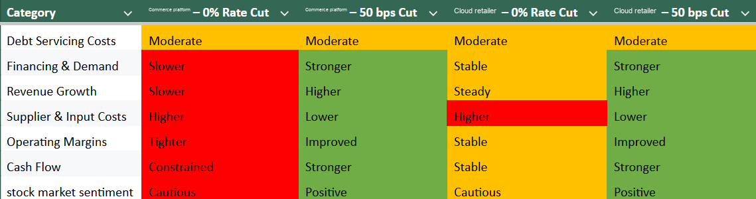
Impact of Fed Rate Cut Scenarios on Commerce Software Platform and Cloud and Retail Business – Operational & Financial Metrics
🔴 Light red = negative / restrictive outcomes (higher costs, slower growth, cautious outlook).
🟠Yellow/Orange: Neutral or moderate outcomes.
🟢 Light green = positive outcomes (lower costs, stronger demand, improved margins).

